Slide 1
Net neutrality conference - EP
Harald Krohg, Director Wholesale & Regulatory, Telenor Norway

Slide 2

Telenor has supported the pragmatic Nordic approaches to Net neutrality
Norwegian guidelines
Internet users are entitled to a connection
with a predefined capacity and quality.
that enables them to
- send and receive content of their
choice
- use services and run applications of
their choice
- connect hardware and use software of
their choice that do not harm the
network.
that is free from discrimination with regard to type of application, service or content or based on sender or receiver address.
Basis for common understanding
Focus on customers rights
Positive side effects for all stakeholders
http://www.npt.no/ikbViewer/Content/109607/Retningslinjer_for_nettn%c3%b8ytralitet.pdf

Slide 3
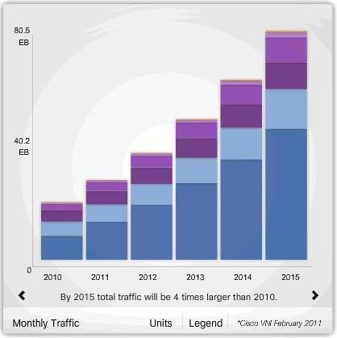
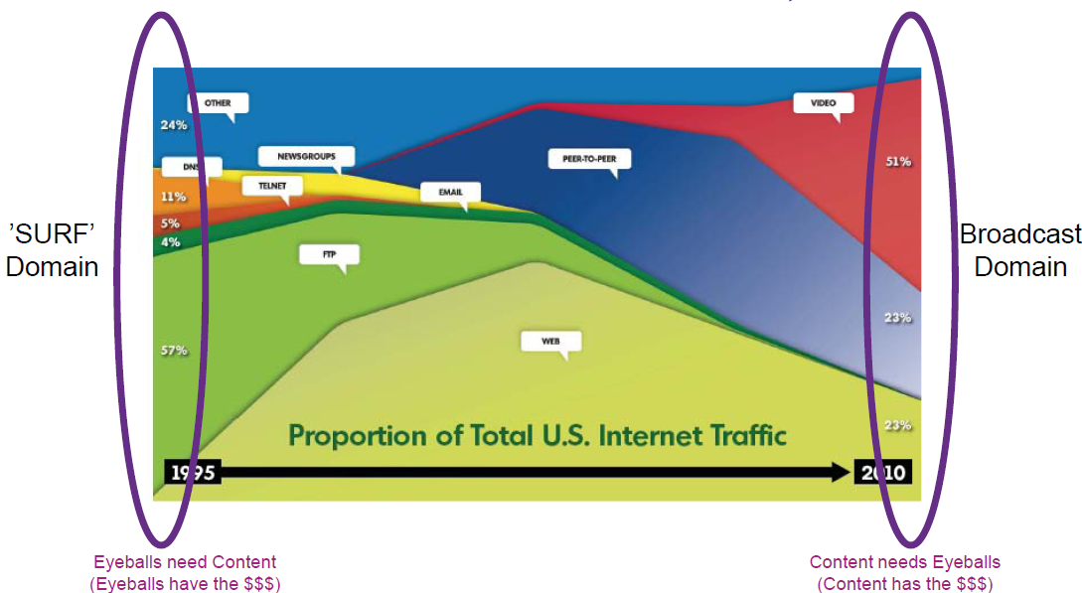
Internet traffic growth
CAGR fixed 40%; mobile 100%
Telenor experiences growth in line with Cisco projections
Internet content development
From Surf to Broadcast
Source: TeliaSonera International Carrier

Slide 4

Thank you!
harald.krohg@telenor.com

